Slide 1
Employee Turnover Predictor
Final Project Presentation
Liban Dahir · Logan Simba · Ahmad Mouhsen
COS 470 Software Development

Slide 2
Agenda
Problem and project goal
Design, architecture, and workflow
Machine learning pipeline and risk scoring
Live demo of the running web app
AI usage, challenges, lessons learned, and team contribution

Slide 3
Problem and Goal
Turnover is costly and often discovered too late.
Managers need early, practical risk signals.
Goal: predict turnover risk and provide actionable retention guidance.

Slide 4
Requirements Summary
Functional Requirements
• Import employee data from CSV/Excel.
• Predict employee turnover probability.
• Filter by department, tenure, and risk level.
• Provide recommendation-focused views for at-risk employees.
Non-Functional Requirements
• Usable by non-technical users.
• Fast interactive dashboard updates.
• Modular architecture for maintainability.
• Responsible handling of employee data.

Slide 5
System and Data Overview
Dataset: turnover.csv (1,129 rows, 16 columns).
Target variable: event (1 = leave, 0 = stay).
Core features include tenure, role context, coaching, compensation, and behavioral factors.

Slide 6
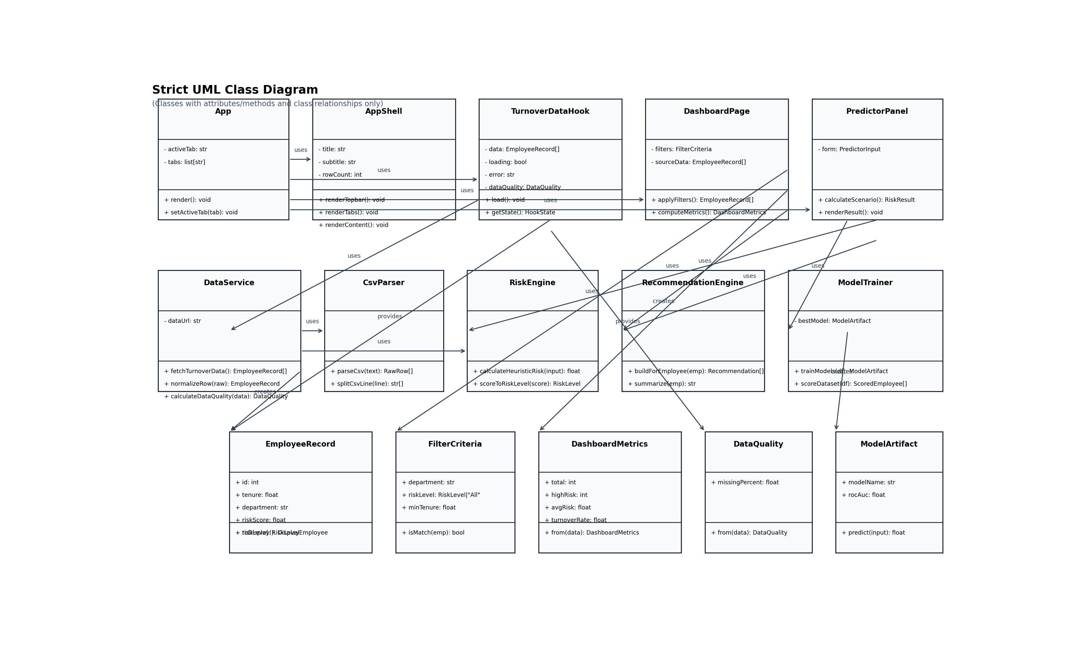
Class Diagram
• Classes are organized by presentation, service, and data responsibilities.
• Methods and dependencies are explicit for maintainability.
• Design follows single-responsibility and separation-of-concerns principles.

Slide 7
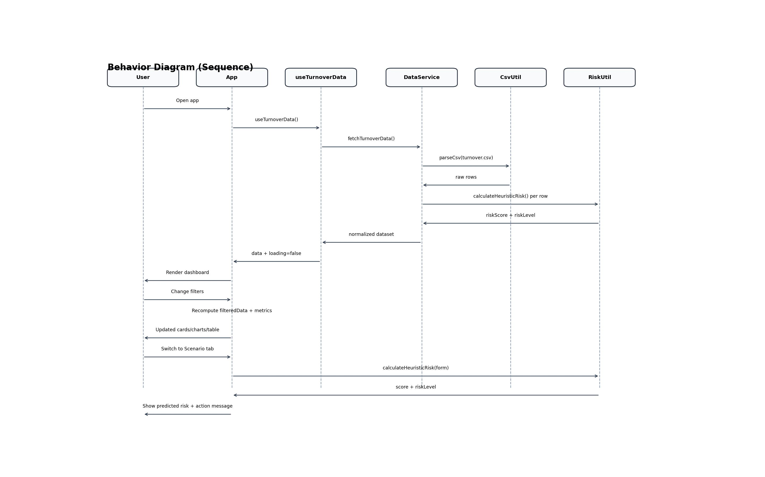
Behavioral Diagram
• Captures runtime sequence from app launch to prediction output.
• Shows interaction flow between UI, data loading, and risk scoring components.
• Includes conditional branches for filter updates and scenario prediction.

Slide 8
Machine Learning Pipeline
Step 1: Preprocess (missing values + categorical encoding).
Step 2: Train/Test split for evaluation.
Step 3: Train Logistic Regression and Random Forest.
Step 4: Select best model by ROC-AUC and generate risk scores.

Slide 9
Risk Scoring and HR Actions
Low: < 0.40, Medium: 0.40-0.69, High: >= 0.70.
Dashboard highlights high-risk employees and department-level patterns.
Recommendations support manager follow-up, onboarding support, and coaching actions.

Slide 10
Live Demo Plan (Running on Localhost)
What We Will Show
• Overview KPIs and dynamic filtering.
• At-risk employee table with suggested focus actions.
• Scenario tab with live risk recalculation.
• Guide tab for plain-English interpretation.
Demo Environment
• React app launched via npm run dev.
• Local dataset loaded from frontend/public/data/turnover.csv.
• GitHub repository ready as backup evidence.
• Screenshots prepared in case of connectivity issues.

Slide 11
AI Usage
Tools Used
• AI assistant (Codex/ChatGPT style tooling).
• Used for drafting UI structure, slide language, and diagram refinement.
• Used for productivity support, not blind copy-paste.
Verification and Limits
• All generated content was reviewed, edited, and tested by the team.
• Model/UI outputs were validated against dataset behavior.
• Limitation: AI can suggest incorrect assumptions if not verified.

Slide 12
Challenges and Lessons Learned
Challenges
• Balancing model accuracy with interpretability for non-technical users.
• Cleaning raw data and mapping unclear categorical labels.
• Keeping presentation visuals readable while staying technically correct.
Lessons Learned
• Early architecture decisions reduce rework later.
• User-facing language matters as much as model output.
• Rapid prototyping + structured verification is effective.

Slide 13
Team Contribution
Contribution Summary
Liban Dahir: system integration, dashboard implementation, and presentation assembly.
Logan Simba: requirements/design support, UML refinement, and validation review.
Ahmad Mouhsen: data/model analysis support and documentation contributions.

Slide 14
Conclusion and Next Steps
The project delivers a working turnover-risk decision support prototype.
Next steps: stronger testing coverage, CI/CD pipeline, and explainability modules.
Questions?

